Slide 1
Successfully Virtualizing SQL Server on vSphere: Straight from the Source
Gianluca Hotz
President UGISS.ORG
VMWare Expert Database Program (SQL Server)
Notes:
M2 technical Deck (12-2017)

Slide 2
Agenda
vSphere supports of SQL Server High Availability Options
vSphere Platform Configuration Recommendations

Slide 3

Clustering SQL Server on vSphere

Slide 4
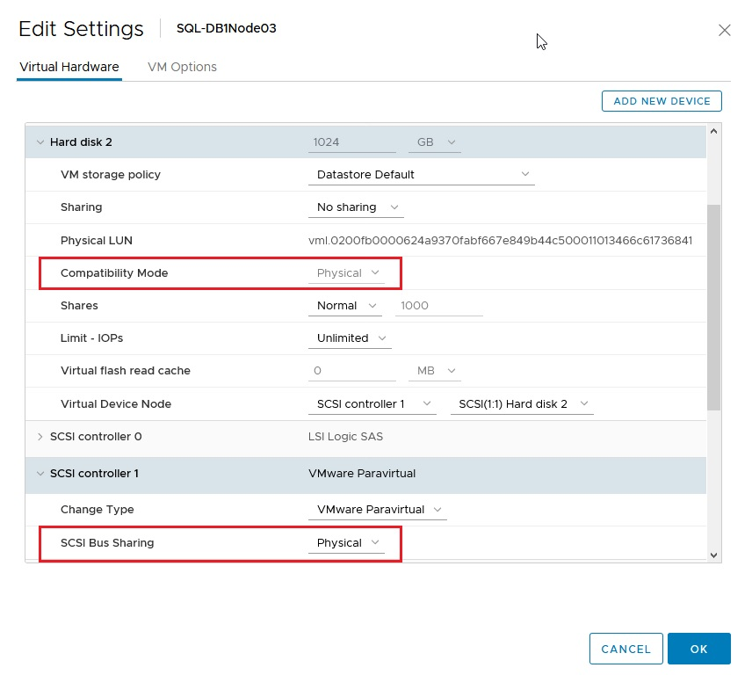
SQL Server High Availability Options
SQL Server FCI (Failover Cluster Instances)
Provides HA on the SQL Server Instance level with WSFC
Require a shared disk(s) between VMs
Require support of SCSI3 Persistent Reservations by Storage Array
Supported on VMware vSphere:
Use vSphere 6.x (preferably 6.5 or higher)
Use pRDMs in physical compatibility mode as shared storage
Configure vSCSI controller to use physical SCSI Bus Sharing
Require DRS Anti-Affinity Groups
vSphere 6.7 enables use of VVOLs instead of pRDMs and VMDK on vSAN
vSphere 6.X supports vMotion of a VM with pRDMs in physical compatibility mode
NOTES:
Multi-writer flag is no supported no required!
Support for shared VMDK on VMFS is not there yet, but coming soon!
Notes:
vVOL another way to present a LUN from the physical server

Slide 5
SQL Server High Availability Options
SQL Server Always On Availability Groups
Provides HA on the database level (SQL Server 2016 and higher recommended)
Relies on SQL Server replication over network (sync/async) to synchronize databases between members of AGs
Use a components of WSFC but does not require a shared storage
Supported on VMware vSphere with no restrictions / special configurations requirements:
DRS Anti-Affinity Groups are recommended
Tuning Heartbeat settings of WSFC is recommended
10 GE or higher network circuit for the vMotion network is required

Slide 6
vSphere Platform Configuration Recommendations

Slide 7
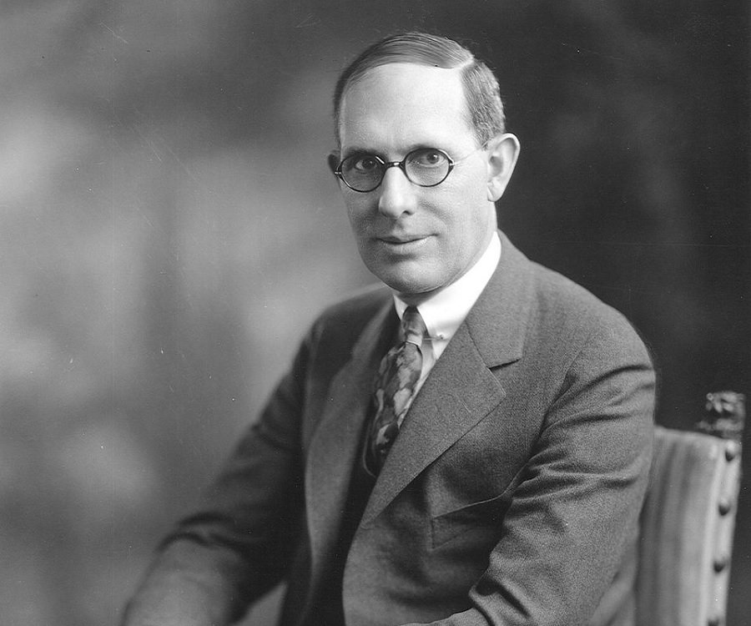
“A problem thoroughly understood is always fairly simple. Found your opinions on facts, not prejudices. We know too many things that are not true.”
Charles Kettering
Inventor and philosopher
General Motors
Notes:
Oleg complains about app performance decrease!

Slide 8
Ensuring Microsoft SQL Server Performance on vSphere
Physical Hardware
VMware HCL
BIOS / Firmware
Hyper-threading
Power / C-States
ESXi Host
Power Policy
Virtual Switches
Virtual Machine
Resource Allocation
Storage
Memory
CPU / vNUMA
Networking
vSCSI Controller
Guest Operating System
CPU
Power
Networking
Storage IO
vMotion Portgroups
NUMA

Slide 9
vCenter objects
vCenter Server Configuration:
Statistic levels
ESXi Cluster Compute Resource Configuration:
vSphere High Availability -- ON
Admission control – Failover Host
DRS Cluster - ON (Fully automated)
VMware Enhanced vMotion Compatibility -- OFF
Resource Pools – AVOID !should not be used as folders for virtual machines!

Slide 10
Physical Server BIOS/UEFI and Firmware Versions
Hardware MUST Be On VMware’s HCL
Outdated Drivers, Firmware and BIOS Revs Adversely Impact Virtualization
Always Disable unused physical hardware devices
Enable Turbo Boost.
Enable Hyper-Threading.
Verify that all ESXi hosts have NUMA enabled in the BIOS/UEFI. In some systems (for example, HP Servers), NUMA is enabled by disabling node interleaving. Consult your server hardware vendor for the applicable BIOS settings for this feature.
Enable advanced CPU features, such as VT-x/AMD-V, EPT, and RVI.
Follow your server manufacturer’s guidance in selecting the appropriate Snoop Mode

Slide 11
Power Management
Default Hardware Power Scheme Unsuitable for Virtualization
Change BIOS Power setting to “OS controlled”
Set ESXi Power Management Policy to “High Performance”
Enable Turbo Boost (or Equivalent)
Disable Processor C-states / C1E halt State

Slide 12
Virtual Machine CPU Configuration
Cores per Socket:
Total vCPU = (Number of virtual Socket) * (Number of virtual Cores per socket)
Reflect your hardware configuration while configuring cores per socket ratio
CPU Hot Plug – Disabled
CPU Affinity - Disabled
CPU Reservations - might be used in the overcommitted environment
Per Virtual Machine EVC Mode – For Cross-migrations!
vNUMA – stay with one pNUMA and check the resulting configuration

Slide 13
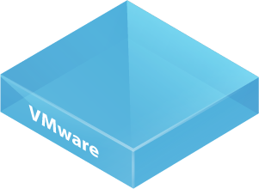




Optimizing Performance – Know Your NUMA
8 vCPU VMs
less than
45GB RAM
on each VM
ESXi Scheduler
If VM is sized greater
than 45GB or 8 CPUs,
Then NUMA interleaving and
subsequent migration
occur and can cause
30% drop in memory
throughput performance
Memory
Memory
Memory
Memory
Proc 1
Memory
Memory
Proc 2
Memory
Each NUMA
Node has 94/2
45GB (less 4GB for
hypervisor overhead)
Memory
Memory
Memory
96 GB RAM, 2x8 Cores
on Server
Memory
Memory

Slide 14
NUMA Considerations
General Rules (applies to all versions of vSphere starting with 5.0):
vNUMA is not exposed for any VM having less than nine (9) vCPU assigned (default).
vNUMA is not exposed to any VM having less vCPU than the size of pNUMA of a host (default).
vNUMA is not exposed if the “CPU hot add” feature is enabled

Slide 15
vNUMA
The VM memory size is not considered for the creation of the vNUMA topology. For the “unbalanced NUMA” memory configuration (amount of configured memory span NUMA nodes while vCPU count stays within a NUMA node) see recommendation on the Section 3.6.2.4 and consider using Advanced Configuration#1 (page 33).
vNUMA topology for a VM is created only once and by default is not updated if a VM is vMotioned to a server hardware with a different pNUMA configuration.
VM hardware version 8 is required to have vNUMA exposed to the Guest OS.
vNUMA topology will be updated if changes for the CPU configuration of a VM is done. pNUMA information from the host, where the VM was started at the time of the change will be used for creating vNUMA topology. Changing memory configuration will have no effect on vNUMA topology.

Slide 16
Check NUMA topology
For ESXi host:
esxcli hardware memory get | grep NUMA
sched-stats -t ncpus
For Virtual Machine (VM):
vmdumper -l | cut -d \/ -f 2-5 | while read path; do egrep -oi “DICT.*(displayname.*|numa.*|cores.*|vcpu.*|memsize.*|affinity.*)= .*|numa:.*|numaHost:.*” “/$path/vmware.log”; echo -e; done

Slide 17
NUMA: Changes in vSphere 6.5
vSphere 6.0 and below:
reflect you server hardware pNUMA topology configuring the cores:socket ratio.
Vsphere 6.5
Autosizing of the vNUMA is introduced. “Cores per Socket” setting is not taken into account while creating the vNUMA topology. The final vNUMA topology for a VM will be automatically configured by ESXi using the number of physical cores per CPU package of the physical host
where VM is about to start.

Slide 18
NUMA: Best Practices
Best possible performance generally is observed when a VM could fit into one pNUMA node and could benefit from the local memory access. For example, when running a VM hosting SQL Server on a host with twelve pCores per pNUMA, as a rule of thumb, assign no more than twelve vCPUs to a VM. This statement especially applies for SQL Servers licensed with the Standard Edition, which has no NUMA optimization.
b. If a wide-NUMA configuration is unavoidable, consider reevaluating the recommendations given and execute extensive performance testing before implementing the configuration. Monitoring should be implemented for important CPU counters after moving to the production.

Slide 19
Virtual Machine Memory Configuration
Avoid overcommitment of memory at the ESXi host level
Consider setting the memory reservation equal to the provisioned memory.
Consider using SQL Server native performance metrics (available using SQL Server DMVs)
Consider checking the hardware pNUMA memory allocation (% of Remote Memory)
Always install VMware Tools (leave the balloon driver enabled)
Memory Hot Plug - has no performance impact
Notes:
When a SQL Server deployment is virtualized, the hypervisor performs virtual memory management without the knowledge of the guest OS and without interfering with the guest OS’s own memory management subsystem

Slide 20
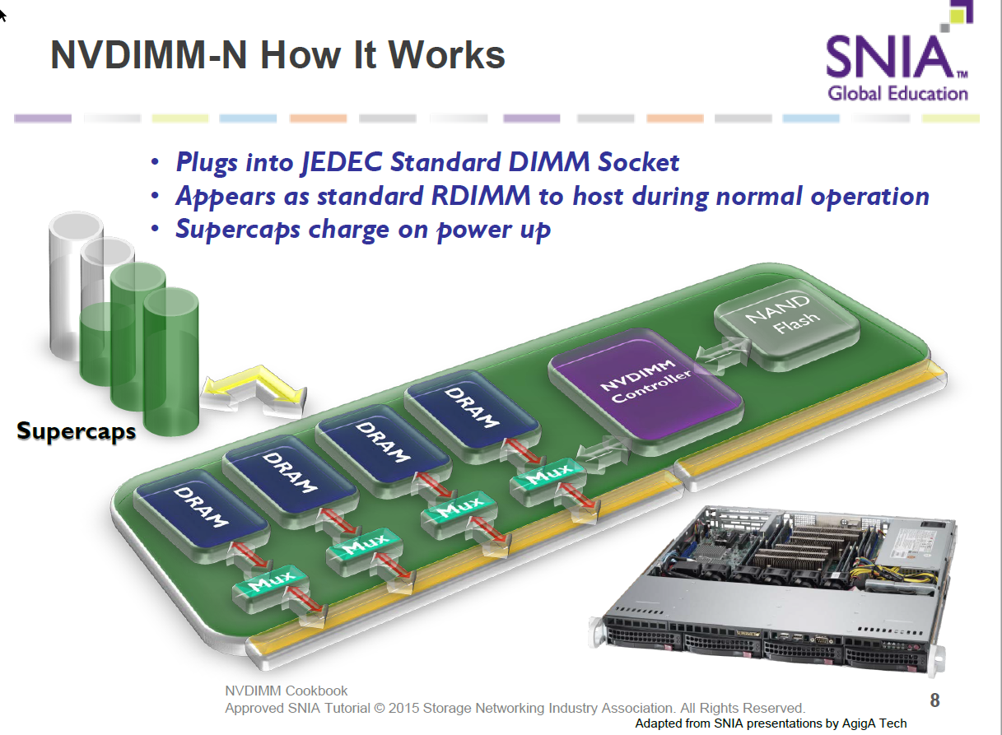
Persistent Memory (NVDIMM-N)
Using a “normal” DIMM slot
Contains Supercaps Charging modules
NAND Flash to store DRAM content on power lose

Slide 21
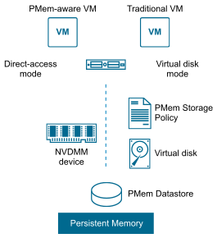
Application with PMem
vPMem - the memory is exposed to a guest OS as a virtual NVDIMM. This enables the guest OS to use PMem in byte addressable random mode (DAX).
Virtual Persistent Memory Disk (vPMemDisk) - the memory can be accessed by the guest OS as a virtual SCSI device, but the virtual disk is stored in a PMem datastore
Notes:
Current Limitations:
vSphere HA is NOT supported
To place host in maintenance mode ALL VMs (including powered off) must be migrated and reconfigured. Namespaces must be removed and recreated after a reboot
VM level backup is NOT supported

Slide 22
Virtual Machine Storage Options
VMFS (VMWARE VIRTUAL MACHINE FILE SYSTEM)
VMFS version 6, used as the default in vSphere 6.5 and 6.7:
Do not use VMFS3 or VMFS3 upgraded DS
NFS:
Fully Supported both by VMware and Microsoft except for shared cluster disks
RDM (RAW DEVICE MAPPING):
directly access a volume on the physical storage subsystem without formatting it with VMFS
Virtual Volumes:
Direct interaction and exposing capabilities of a storage system
Require VASA provider

Slide 23
VMFS or RDM?
Generally similar performance http://www.vmware.com/files/pdf/performance_char_vmfs_rdm.pdf
Disk size no longer a limitation of VMFS (62TB from vSphere 5.5)
VMFS | RDM
Better storage consolidation – multiple virtual disks/virtual machines per VMFS LUN. But still can assign one virtual machine per LUN | Enforces 1:1 mapping between virtual machine and LUN
Consolidating virtual machines in LUN – less likely to reach vSphere LUN Limit of 255 | More likely to hit vSphere LUN limit of 255
Manage performance – combined IOPS of all virtual machines in LUN < IOPS rating of LUN | Not impacted by IOPS of other virtual machines
When to use raw device mapping (RDM)
Required for shared-disk failover clustering
Required by storage vendor for SAN management tools such as backup and snapshots
Otherwise use VMFS

Slide 24
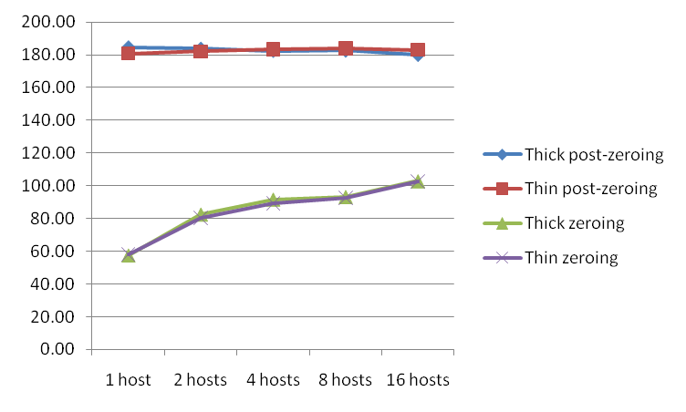
“Thick” vs “Thin”
MBs I/O Throughput
Thin (Fully Inflated and Zeroed) Disk Performance = Thick Eager Zero Disk
Performance impact due to zeroing, not result of allocation of new blocks
To get maximum performance from the start, must use Thick Eager Zero Disks (think Business Critical Apps)
Maximum Performance happens eventually, but when using lazy zeroing, zeroing needs to occur before you can get maximum performance
Choose Storage which supports VMware vStorage APIs for Array Integration (VAAI)
http://www.vmware.com/pdf/vsp_4_thinprov_perf.pdf

Slide 25
VSPHERE VIRTUAL VOLUME
VVols defines a new virtual disk container (the virtual volume) that is independent of the underlying physical storage representation (LUN, file system, object, and so on.). It
Storage Policy- Based Management (SPBM)
Array-based replication starting from VVol 2.0 (vSphere 6.5)
Support for SCSI-3 persistent reservation starting from vSphere 6.7
VASA support from the storage vendor is required for vSphere to leverage VVol.

Slide 26
VMWARE VSAN
VMware software-defined storage solution for hyper-converged infrastructure (HCI)
Consider to use All-Flash vSAN, preferably with NVMe drives
Use at least FTT = 1
Use RAID1 for SQL Server data, log files and tempdb
Object space reservation =100%
Use multiple VMDK per workload attached to different PVSCSI controllers
Redundant and high-performance (at least 10 Gbit) vSAN network

Slide 27
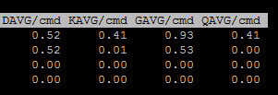
Storage Best Practices
Partition Alignment (default to 1 MB boundaries)
Eager zeroed thick or thin
Separate the workload between VMDKs (up to 256 in vSphere 6.7)
Use PVSCSI virtual controller (up to 4 per VM) / Configure Controller queue in Guest OS
Monitor Queue Depth on ESXi host (DAVG + KAVG == GAVG; KAVG ~0; DAVG – time to send IOPS to Storage and back including SAN delays):
Limit the use of snapshots (VM based backup using snapshots should be avoided)

Slide 28
Network Virtualization

Slide 29
Networking Recommendations
Separate traffic between different port groups and physical NICs
Use jumbo frame for vMotion (not needed/hard to consistently configure for VM networks)
10 GE vMotion network or higher
VMXNET3 and latest VMware Tools

Slide 30
vSphere Security
Virtual Machine Encryption
vSphere 6.7. New Security Features
Support for a virtual Trusted Platform Module (vTPM) for the virtual machine.
Support for Microsoft Virtualization Based Security.
Enhancement for the ESXi “secure boot.”
Virtual machine UEFI Secure Boot.
FIPS 140-2 Validated Cryptographic Modules

Slide 31
Maintaining a Virtual Machine
Upgrade VMware Tools - use the latest version, tools are de-coupled from ESXi host
Upgrade the Virtual Machine Compatibility – vHardware to match your ESXi host version

Slide 32
Windows Server Configuration
Power Policy – use High-Performance Power Plan to avoid core parking
Enable Receive Side Scaling (RSS) / check with Netsh int tcp show global
Increase PVSCSI queue depth
Configure exceptions for Antivirus Software
Other Applications – do not use together with SQL Server
Always Install VMware tools

Slide 33
Linux Server Configuration
Supported distro:
Red Hat Enterprise Linux (RHEL) 7.3 or 7.4;
SUSE Linux Enterprise Server (SLES) v12 SP2;
Ubuntu 16.04.
VMware Tools
Configure Power Scheme
Enable Receive Side Scaling

Slide 34
SQL Server Configuration
Maximum / Minimum Server Memory
Lock Pages in Memory
Large Pages
CXPACKET, MAXDOP, and CTFP
Instant File Initialization

Slide 35
VMware Enhancements for Deployment and Operations
VMware NSX
VMware vROPs + Blue Medora SQL MP

Slide 36
Thank you

Slide 37
Resources
Running SQL Server on VMware vSphere: https://blogs.vmware.com/apps/microsoft/sql
SQL Server Configuration Recommendation: http://www.vmw.re/sql-arch
SQL Server on vSphere: Resources: https://blogs.vmware.com/apps/microsoft-resources

